Slide 1
BRITTISH AIRWAYS
Customer ratings analysis and KPIs

Slide 2
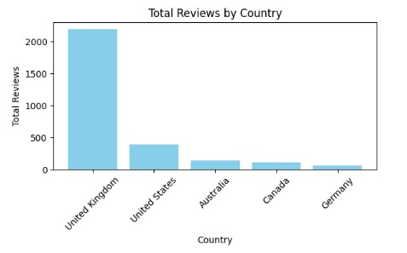

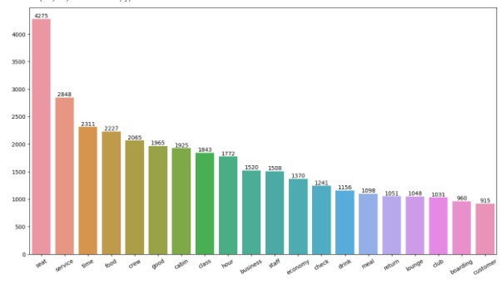
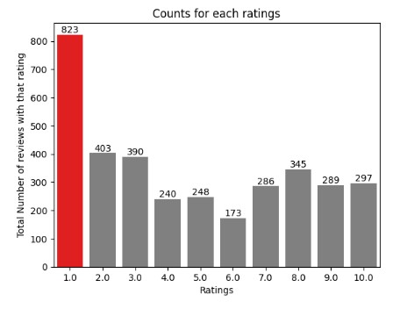
Key Performance Indicators
AVG Star rating: 4.9/10
Total reviews collected: 3494
Number of unique countries: 68
Stars 7-10: Customers are happy with the business class experience and cabin crew service
Stars 4-6: They feel that the service in business class is average from leg space and bathroom
Stars 1-3: They paid for traveller plus premium prices but do not feel as if the experience was worth the money
The most frequent word used in each rating is in regards to the seat, which is then followed by service and time. British Airways should focus on keeping customer satisfaction high on business class and ensure that customers get what they pay for and also look at the economy class and give them a good experience as well. The cabin crew is doing a good job in giving customers a good experience

